Slide 1

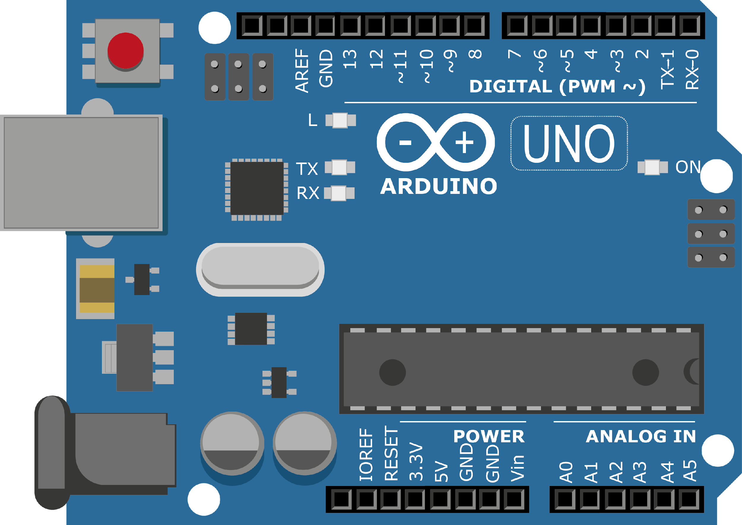
ARDUINO MASTER CLASS
25
Stepper Motor Control

Slide 2
25 AGENDA
02
03
01
Interfacing Stepper Motor
Stepper Motor
Interview questions & News

Slide 3
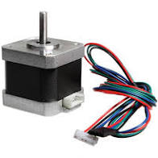
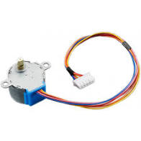
Stepper Motor
A Stepper Motor or a step motor is a brushless, synchronous motor, which divides a full rotation into a number of steps. Unlike a brushless DC motor, which rotates continuously when a fixed DC voltage is applied to it, a step motor rotates in discrete step angles.
The stepper motor is used for precise positioning with a motor, such as hard disk drives, robotics, antennas, telescopes, and some toys.
Stepper motors cannot run at high speeds, but have a high holding torque.

Slide 4
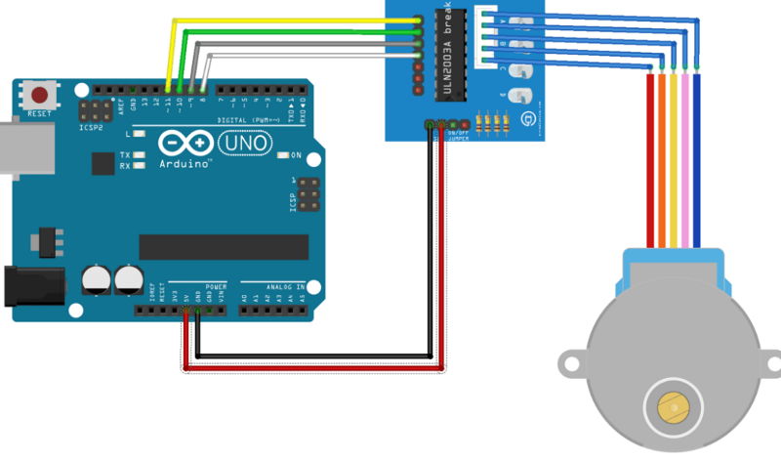
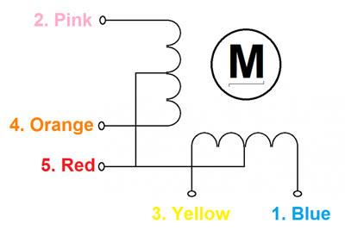
Stepper motor - Arduino

Slide 5

INTERVIEW QUESTIONS
Multiplexer
Maxterm and Minterm
malloc & calloc
multiplexer is a digital control which combines all the digital information from numerous sources and gives one output.
calloc function initialize the allocated memory with 0 but malloc don’t. So the memory which is allocated by the malloc has the garbage data. In another word you can say that calloc is equal to the combination of malloc and memeset.
Minterm - Product of sum because they are the rational AND of the place of variables
Maxterm - sum of product because they are the rational OR of the place of variables.

Slide 6

THANKS!

